Slide 1

BLOCKCHAIN
Prof. Sunitha R
Department of Computer Science Engineering

Slide 2

BLOCKCHAIN
Permissioned Blockchain
Prof. Sunitha R
Department of Computer Science Engineering

Slide 3
BLOCKCHAIN
Learning content
Learn the permissioned blockchain structure, Working Procedure and construction.

Slide 4
BLOCKCHAIN
Permissioned Blockchain
It is a closed ecosystems that can only be accessed by those who are allowed access.
Anyone who is interested in validating transactions or viewing data on the network needs to get approval from a central authority.
Ripple, Hyperledger , Quoruma are the perfect examples of a permissioned blockchain.

Slide 5
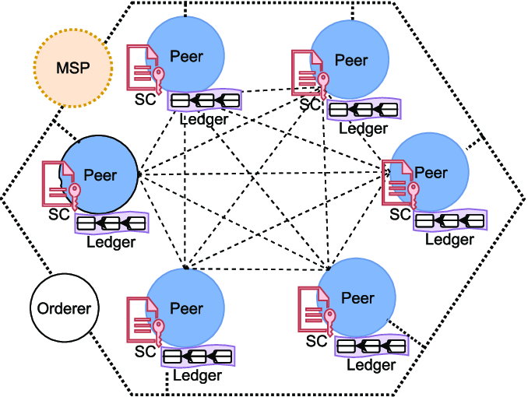
BLOCKCHAIN
Permissioned Blockchain
Notes:
In light of this, a new permissioned Blockchain, Hyper-
ledger has been developed for a variety of networks. Hyper-
ledger [10] introduces six business frameworks: Fabric [11],
Burrow, Iroha, Sawtooth, Indy, and Quilt. Depending on tech-
nological requirements and wide variety of consensus algo-
rithm [12], different frameworks can be utilized. Hyperledger
Fabric can be used as a foundation for developing Blockchain
solutions targeted for IoT network. The basic components of
a permissioned Blockchain architecture has been shown in
Fig. 1. BC network is formed through interconnection of peers,
where peers are independent servers. They are responsible
for validation and endorsement of transactions, and maintain
the distributed ledger. Validation and endorsement process are
mostly dependent on smart contract (chaincode) which must
be installed on every endorsing peer. Basically, smart contract
is a programmatic code to deﬁne the transaction rule or
policy in between sender and receiver. Successfully endorsed
transactions are stored as a block into a common ledger which
is integrated with peers. Many transactions may ﬁt into a single
block which must be linked with the last block of the ledger by
hash value, which makes a chain of blocks

Slide 6
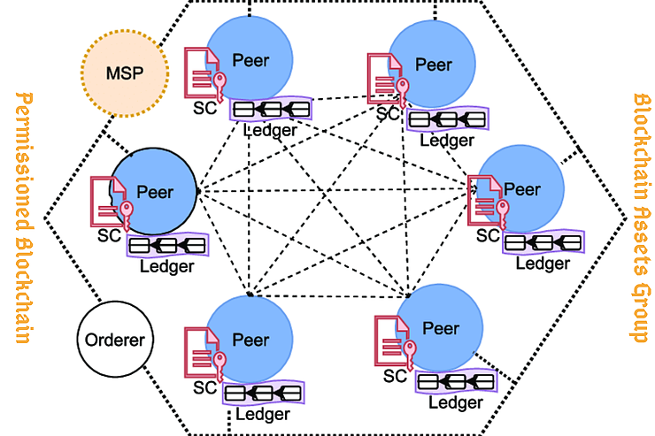
BLOCKCHAIN
How it works?
Notes:
While permissionless blockchains are increasingly gaining acclaim in the world of business, many firms are now beginning to take cognizance of the many upsides to adopt blockchains to augment their systems. They do this to instill trust, transparency, and, in the case of B2B exchanges, efficiency. For example, the Hyperledger Foundation is the pioneering open-source initiative for B2B blockchains.
In a permissioned blockchain, the showrunners are members of a consortium, and stakeholders opt-in to create a network. Pre-approved entities are the only ones who can run the node which validates transaction blocks and execute blockchain-based smart contracts. With permissioned blockchains, it is easy to share trusted information in a secure context. This is done with the confidentiality that businesses require to operate at top effort.
A permission blockchain is designed to make use of computationally inexpensive consensus algorithms. Compared to permissionless relatives such as the proof-of-work, this blockchain sits on substantially better scalability and performance. Blockchains such as the Hyperledger Fabric have additional innovations in the offing with respect to the roles of the nodes. Generally, they do not use crypto-economic models or monetary tokens because of the nature of the business networks.

Slide 7
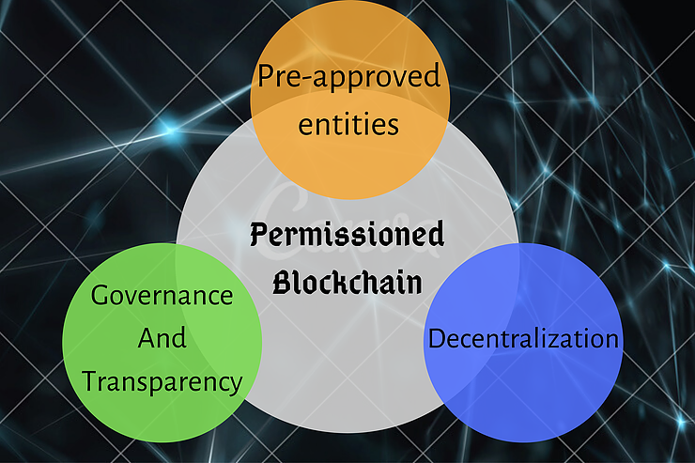
BLOCKCHAIN
Features
Notes:
Governance And Transparency
The semantics of management are very different when it comes to the permissioned and permissionless blockchains. In the former, governance is determined and consented by the members of the blockchain business network. Among peers, code quality, code changes economic incentives, and power allocation are dependent on the dynamics of the business. These parameters are also based on the collective motive for which the network was formed and designed. This way, companies will be able to do things quickly in ways suitable for their models.
For permissioned blockchains, having transparency into the work carried out by each node may not be as essential as it is to the network members in the permissionless sect. Everything is contingent on the way the business relationships are established as well as how the blockchain is configured. Being that a good number of permissioned blockchain networks do not have crypto-economic incentives built into them, the major incentives of the participants is minimizing cost, time, and the ease of sharing information across the platform.
Decentralization
For a permissioned blockchain, the degree of decentralization is dependent on how the members of the network agree to structure their business relationships. The ‘no central control’ concept is relevant in this case, given that the consortiums are managed entities. In the same way, the degree and quality of decentralization on the network rests on the number of peers, the anticipated number of bad nodes in the network, and the caliber of consensus the members decide to use.
Algorithms such as Byzantine Fault Tolerance - which is different from the conventional proof-of-work algorithm used in permissionless blockchains - seem to be the go-to for permissioned networks. Hyperledger Fabric supports almost a dozen consensus algorithms via its plug-in architecture. Decentralization is a given in the design of the blockchain, but having the right governance model is more important. It is more important because power and control structures may not be evenly distributed.

Slide 8
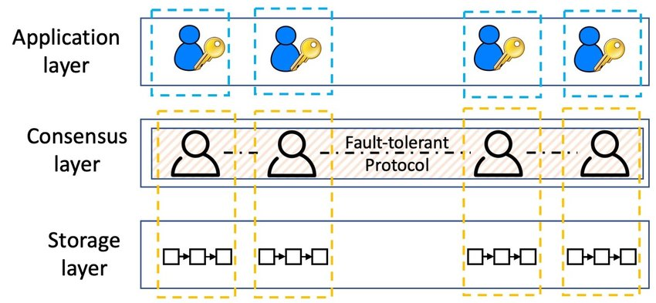
BLOCKCHAIN
Architecture

Slide 9
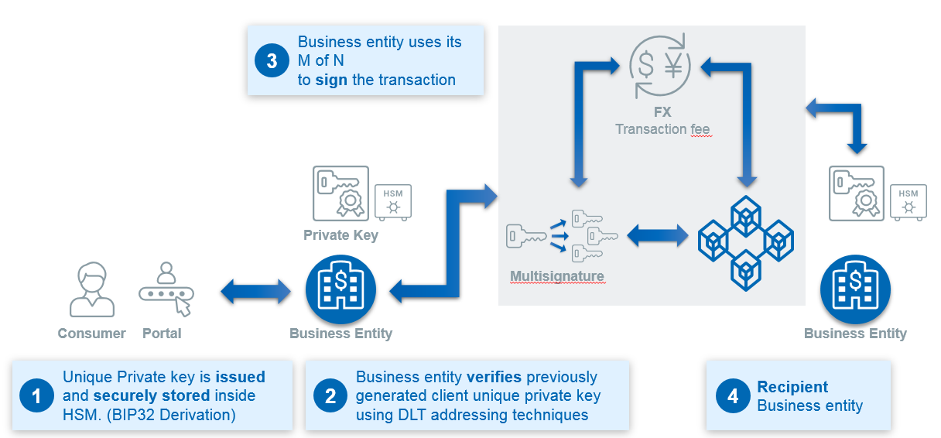
BLOCKCHAIN
Banking Usecase
Notes:
The Blockchain concept works by creating a unique chain of blocks, with each one being “glued” to the next one by a digital signature system. In the context of the banking industry, this may allow checking the history of a digital value and its associated transaction records.
Blockchains prevent actively counterfeited transactions, fraud, and collusion between rogue actors and allow a better, faster, and more efficient Know-Your-Customer (KYC) process. For instance, such technology may also allow interaction with other blockchains like identity blockchains provided by the public sector.
Here is the main lifecycle of a transaction in a permissioned blockchain system:

Slide 10
BLOCKCHAIN
Supplementary readings
https://ieeexplore.ieee.org/document/8946188
https://ieeexplore.ieee.org/document/8970301
https://ieeexplore.ieee.org/document/8854534
Notes:
Public Blockchain Ledger
This blockchain is totally open to all and anybody can join the system. Each member on the chain has full power to access, read and write transactions. Since it is decentralized and wholly distributed, every node gives verification to approve any transaction. Data can’t be altered or manipulated once it is placed on the block. Public blockchains are also called permissionless blockchains.
Being totally open to everyone is the biggest drawback of this type of ledger, since it offers complete transparency with little privacy. Time taken to reach consensus by the network is high because of the numerous nodes present, therefore resulting in high computational power. Bitcoin, Ethereum, etc are popular examples.
Private blockchain Ledger
Also called permissioned blockchains, they have limitations on who is participating in the network. A user is granted access only by the network initiator or by a predefined set of rules. Once a user is given entrance to the network, it can perform the same duties as that of other users. Again, the degree of permissions is decided by the one who initiated the network.

Slide 11
THANK YOU
Sunitha R
Department of Computer Science Engineering
sunithar@pes.edu
+91 80 6666 3333 Extn 721

